Slide 1




Data Analysis on Employee Attrition Data
Team Name: Ducks$Indian
Aakash Rami
CS 513 B
MIS
Graduate
Manan Bhatt
CS 513 B
MIS
Graduate
Rohan Ratwani
CS 513 A
CS
Graduate
Hardik Patel
CS 513 A
CS
Graduate

Slide 2

Problem Statement
With the employee attrition dataset we can uncover various factors that lead to attrition of an employee from a particular company.
To develop a classification models from Provided Attrition Dataset which assists in prediction of the potential of employees leaving the company i.e. gets terminated.

Slide 3
Data Fields
Column Name | Description | Data Type
EMP_ID | Employee ID of each employee | int
ANNUAL_RATE | Annual Salary of employee | int
HRLY_RATE | Hourly Rate of employee | int
JOBCODE | Job Code of employee | int
ETHNICITY | Ethnicity of the employee | string
SEX | Sex of Employee | string
MARITAL_STATUS | Marital Status of Employee | string
JOB_SATISFACTION | How much employee is satisfied with the job within range 1-5 | int
AGE | Age of employee | int
NO_OF_TEAM_CHANGED | Number of teams employee has changed within the organization | string

Slide 4
Data Fields: Continue
Column Name | Description | Data Type
REFERAL_SOURCE | If the employee referred to this job, what was the referral source | string
HIRE_MONTH | In which month employee was hired | string
REHIRE | Whether the Employee was rehired or not | string
TERMINATION_YEAR | If terminated, in which year | int
IS_FIRST_JOB | Is this the first job of the employee | string
TRAVELLED_REQUIRED | Does this job require any travel | string
PERFORMANCE_RATING | How is the performance of the employee in range 1-5 | int

Slide 5
Column Name | Description | Data Type
DISABED_EMP | Is the employee disabled or not | string
DISABLED_VET | Is the employee a disabled veteran or not | string
EDUCATION_LEVEL | What is the education level of the employee | string
STATUS (Target Variable) | Whether the employee is terminated or not | string
JOB_GROUP | In which job group does the employee fall | string
PREVYR_1 | Previous year 1 rating | int
PREVYR_2 | Previous year 2 rating | Int
PREVYR_3 | Previous year 3 rating | Int
PREVYR_4 | Previous year 4 rating | Int
PREVYR_5 | Previous year 5 rating | int
Data Fields: Continue

Slide 6

Data Preprocessing
We found that columns EMP_ID and JOBCODE provides little importance as it contains unique values. So, removed them as they won’t influence in Model.
TERMINATION_YEAR is a categorical feature so missing values were imputed with 0 and denoted it as separate category.
Likewise, REFERAL_SOURCE and ETHNICITY also contained missing values and were replaced the missing values with the mode of the columns i.e. increase the accuracy.
Lastly, We did Data Normalization to normalize the entire dataset bring every column under common scale to reduce biasness from dataset.

Slide 7
The Data
attrition_data.csv :- It contains 9613 rows and 27 columns
Training data :- It contains 7209 rows and selected 10 columns.
Test data :- It contains 2403 rows and selected 10 columns.
Target Variable : STATUS

Slide 8
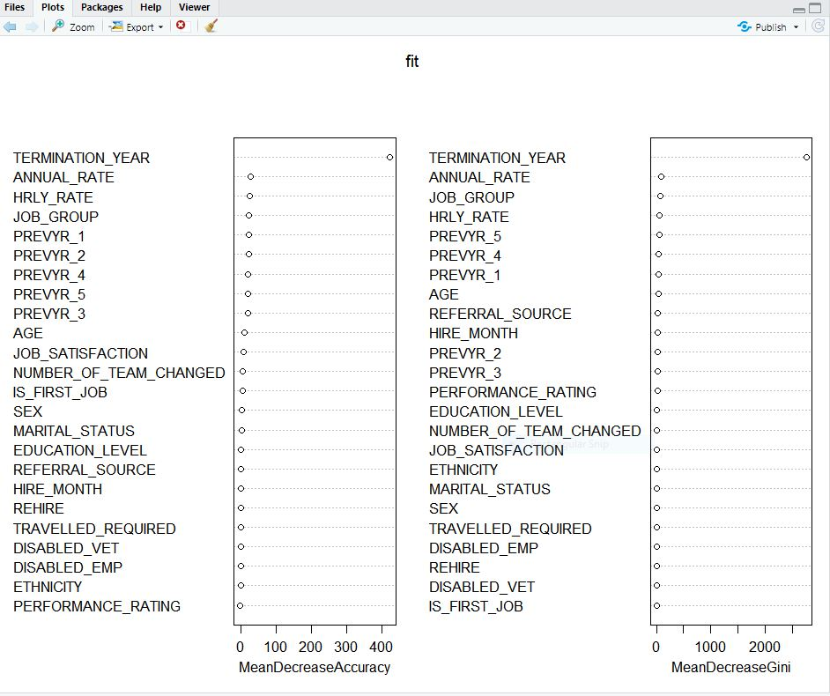
Random Forest : Feature Selection
TERMINATION_YEAR has high importance compared to every other columns. Thus it overpowers different features because of which the importance of other different features diminishes drastically.

Slide 9
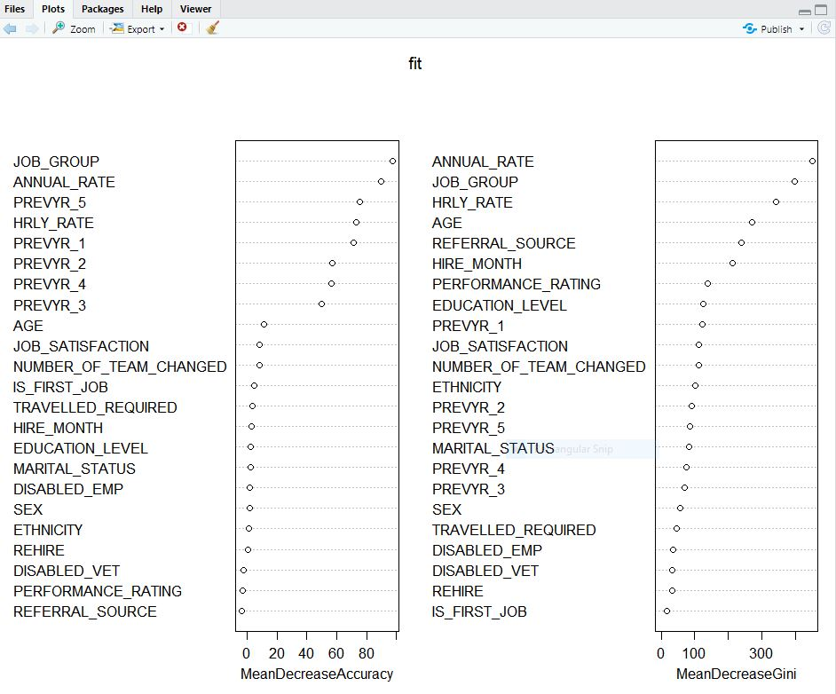
Feature Selection: Continue
We removed TERMINATION_YEAR and measured top 10 features which were important for consideration using Random Forest.
We achieved Accuracy score: 69.76422

Slide 10
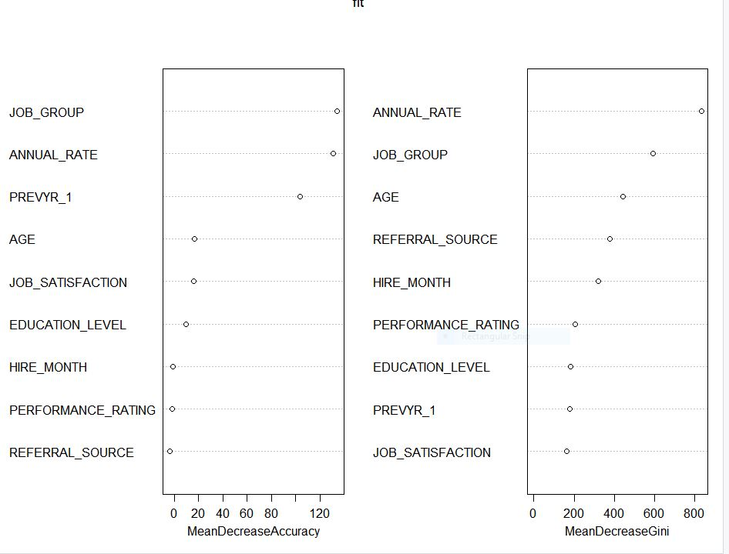
Feature Selection: Continue
We selected and finalized top 10 features which were important to be considered for outcome variable and again tested Random Forest Model.
We achieved Accuracy Score: 70.24965

Slide 11
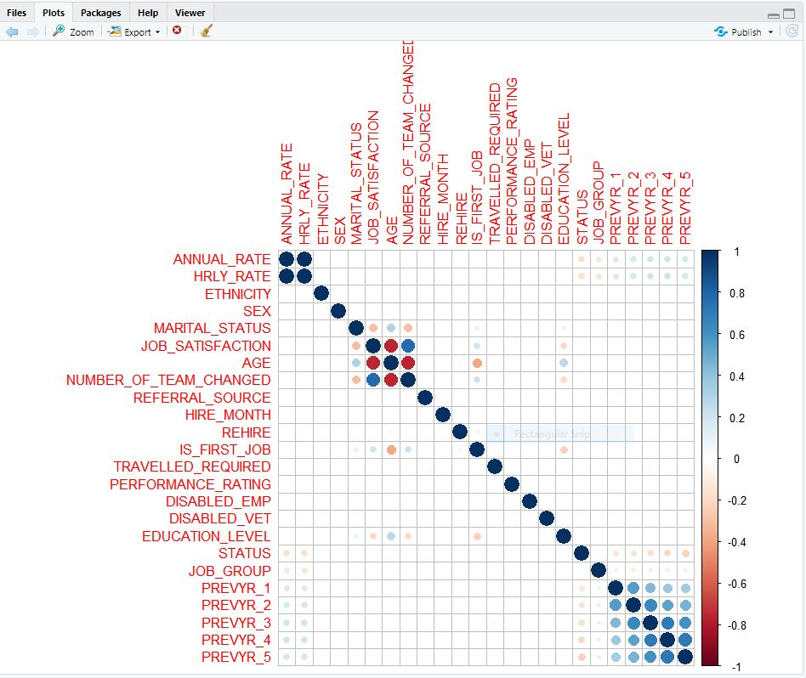
Heat Map between Columns:

Slide 12
Heat Map: Observations
From Heatmap it is evident that none of the column features are highly correlated with target variable (STATUS).
This suggests that Linear Classification Model will not provide useful insights and Hence Non-Linear Models will provide more better results.
ANNUAL_RATE and HOURLY_RATE are highly correlated with each other and Thus, we removed HOURLY_RATE.
PREVYR_1 is loosely correlated to the PREVYR_4 and PREVYR_5 as compared to PREVYR_2, PREVYR_3. So we can include PREVYR_4 and PREVYR_5, but as they both are highly correlated with each other we took PREVYR_4 into consideration.

Slide 13
Models Used
K- Nearest Neighbor(KNN)
Decision Tree
C50
Naïve Bayes
Random Forest
Artificial Neural Network(ANN)

Slide 14
KNN
Value of K | Accuracy (%)
3 | 58.177
5 | 58.645
10 | 60.133
12 | 60.674
15 | 61.173
20 | 61.964
25 | 62.089

Slide 15
Decision Tree
The accuracy of the Decision Tree classifier is 64.33%.

Slide 16
C50
The accuracy of the C50 classifier is 61.205%.

Slide 17
Naïve Bayes:
The accuracy of the Naïve Bayes classifier is 69.02%.

Slide 18
Random Forest
nTree(Number of Tree) | Accuracy (%)
500 | 69.787
800 | 69.496
1000 | 70.162
1200 | 69.954
1500 | 70.037
1600 | 70.037
500 | 69.787

Slide 19
Artificial Neural Network(ANN)
Number of Hidden Layers | Number of Nodes | Threshold | Rep (Iteration) | Learning Rate | Accuracy (%)
1 | 6 | 0.1 | 2 | 0.01 | 66.208
1 | 6 | 0.1 | 2 | 0.2 | 67.374
2 | 6,4 | 0.1 | 1 | 0.1 | 67.862
2 | 6,4 | 0.1 | 1 | 0.2 | 66.126

Slide 20
Conclusion
After running different models we observed the highest accuracy for the Random Forest by changing the hyperparameter of ntree and we observed highest accuracy of 70.16% at ntree = 1000.

Slide 21

Thank you!

